Slide 1
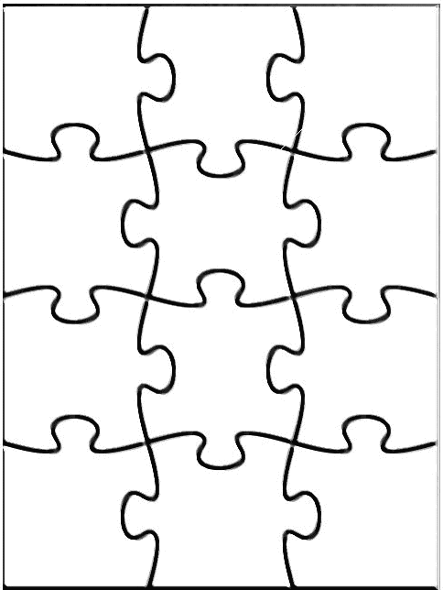
Artificial Intelligence
Agent
Perception
Robotics
Reasoning
Search
Learning
Knowledge rep.
Constraint satisfaction
Planning
Natural language
...
Expert
Systems

Slide 2
Outline of AI Strategies
unknown
RL
known
deterministic
stochastic
atomic
SEARCH
MDPs
factored
LOGIC
Bayes nets
structured
First-order logic

Slide 3

Why Game Examples
Across history, puzzles and games requiring the exploration of alternatives have been considered a challenge for human intelligence:
Chess originated in Persia and India about 4000 years ago
Checkers appear in 3600-year-old Egyptian paintings
Go originated in China over 3000 years ago
So, it’s not surprising that AI uses games to design and test algorithms
3
Notes:
3

Slide 4

Artificial Intelligence
Search
Notes:
3

Slide 5
Motivation
One of the major goals of AI is to help humans in solving complex tasks
How can I fill my container with pallets?
Which is the shortest way from Pune to Delhi?
Which is the fastest way from Pune to Delhi?
How can I optimize the load of my cargo to maximize my revenue?
How can I solve my Sudoku game?
What is the sequence of actions I should apply to win a game?
Sometimes finding a solution is not enough, you want the optimal solution according to some “cost” criteria
All the example presented involve looking for a plan
Plan: the set of operations to be performed of an initial state, to reach a final state that is considered the goal state
Thus, we need efficient techniques to search for paths, or sequences of actions, that can enable us to reach the goal state, i.e., to find a plan
Such techniques are commonly called Search Methods

Slide 6
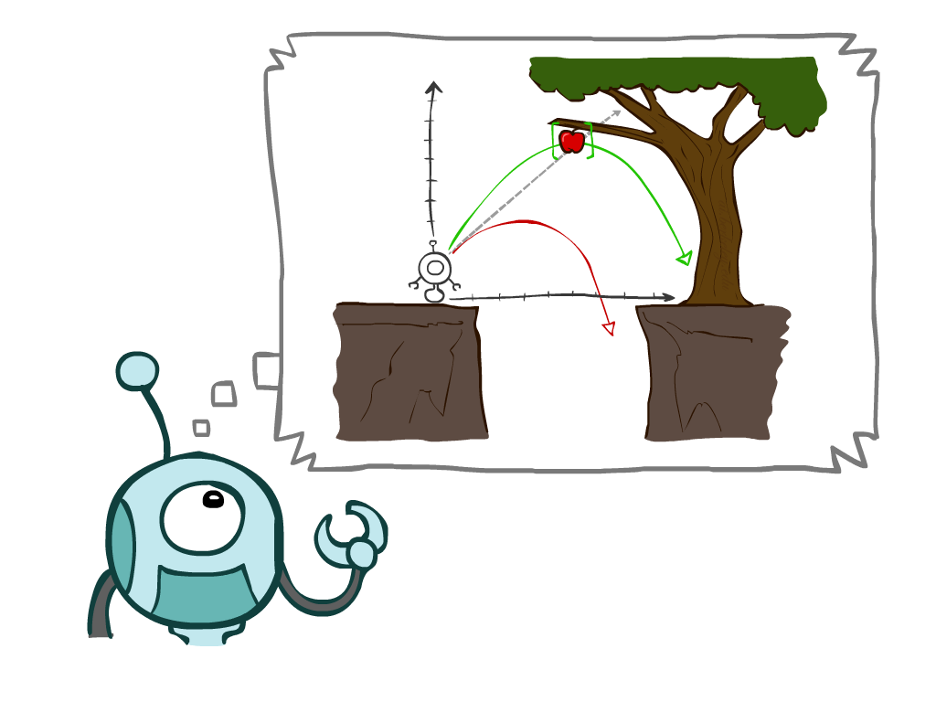
Today
Agents that Plan Ahead
Search Problems
Uninformed Search Methods
Depth-First Search
Breadth-First Search
Uniform-Cost Search
Notes:
General theme in the class:
A goal we have in mind.
A mathematical abstraction to formalize this
Algorithms that operate on these abstractions
3

Slide 7
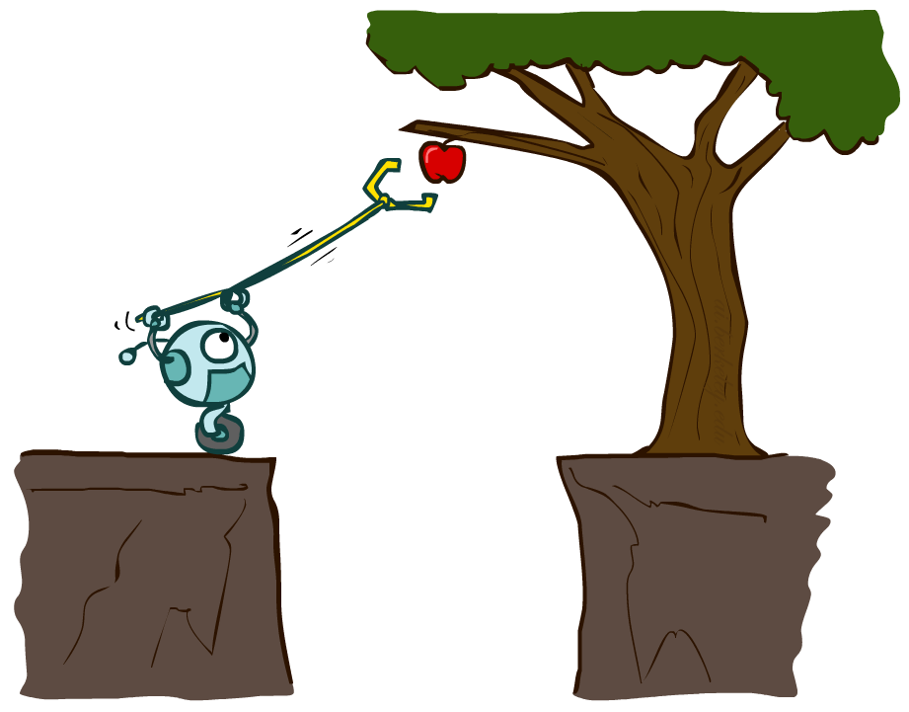
Planning Agents
Planning agents decide based on evaluating future action sequences
Must have a model of how the world evolves in response to actions
Usually have a definite goal
Optimal: Achieve goal at least cost
Notes:
3

Slide 8
Problem solving
(using intelligence similar to human intelligence or using Intelligent Agents )
We want:
To automatically solve a problem.
We need:
A representation of the problem.
Algorithms that use some strategy to solve the problem defined in that representation.
Formalization
Searching technique
3
Notes:
3

Slide 9
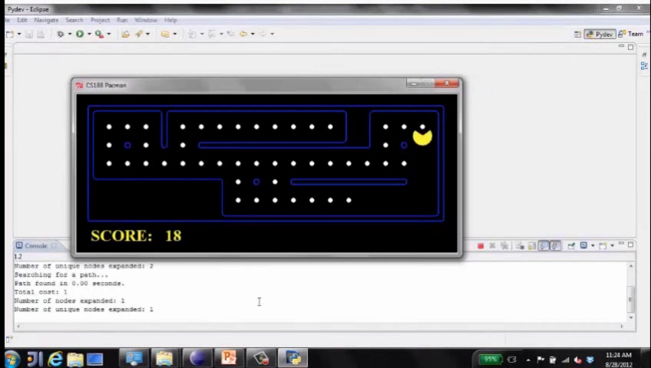
Move to nearest dot and eat it
Notes:
3

Slide 10
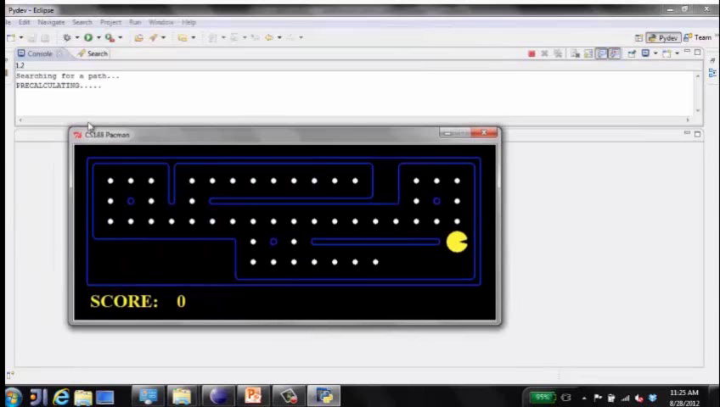
Precompute optimal plan, execute it
Notes:
3

Slide 11

Search Problems
Notes:
3

Slide 12

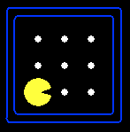





Search Problems
A search problem consists of:
A state space S
An initial state s₀
Actions A(s) in each state
Transition model Result(s,a)
A goal test G(s)
S has no dots left
Action cost c(s,a,s’)
-1 per step; +10 food; +500 win; -500 die; +200 eat ghost
A solution is an action sequence that reaches a goal state
An optimal solution
U
-9
-9
R
Notes:
Often comes back on exams
Goal test – sometimes more than one state that satisfies having achieved the goal, for example, “eat all the dots”
Abstraction
3

Slide 13
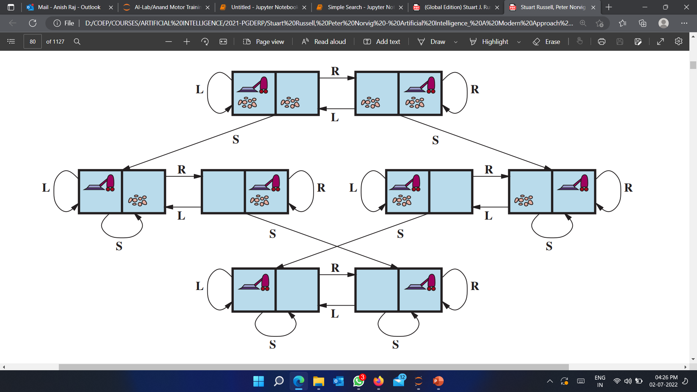
Example-1: Vacuum Cleaner world
States: | Discrete: dirt and robot location
Initial state: | Any
Actions: | Left, right, suck
Goal test: | No dirt at all locations
Path cost: | 1 per action
Solution | Optimal sequence of operations(actions)
3
Notes:
3

Slide 14
Example-2: Traveling in Romania
State space:
Cities
Initial state:
Arad
Actions:
Go to adjacent city
Transition model:
Reach adjacent city
Goal test:
s = Bucharest?
Action cost:
Road distance from s to s’
Solution?
Notes:
3

Slide 15
Example-3: 8-Puzzle
8
2
7
3
4
5
1
6
8
2
8
2
7
8
2
7
3
4
7
3
4
6
3
4
5
1
6
5
1
5
1
6
Search is about the exploration of alternatives
Notes:
3

Slide 16
Example-3: 8-Puzzle
State: Any arrangement of 8 numbered tiles and an empty tile on a 3x3 board
8
2
1
2
3
3
4
7
4
5
6
5
1
6
7
8
Initial state
Goal state
States: | Locations of tiles
Initial State: | Given
Actions: | Move blank left, right, up, down
Goal test: | Goal state (given)
Path cost: | 1 per move
Solution: | Optimal sequence of operators
Notes:
3

Slide 17
8-Puzzle: Successor Function
SUCC(state) → subset of states
The successor function is knowledge about the 8-puzzle game, but it does
not tell us which outcome to use, nor to
which state of the board to apply it.
8
2
7
3
4
5
1
6
8
2
8
2
7
8
2
7
3
4
7
3
4
6
3
4
5
1
6
5
1
5
1
6
Search is about the exploration of alternatives
Notes:
3

Slide 18
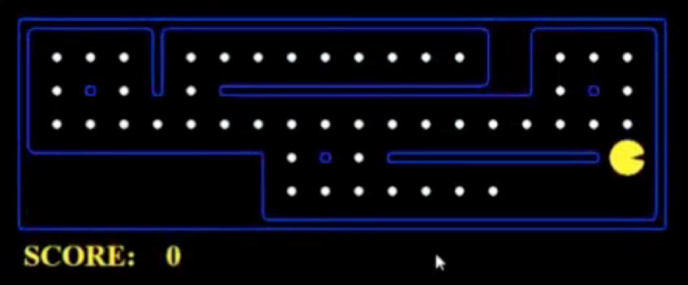
What’s in a State Space?
The world state includes every last detail of the environment
A search state keeps only the details needed for planning (abstraction)
Problem: Pathing
States:
Actions:
Transition:
Goal test:
Problem: Eat-All-Dots
States:
Actions:
Transition:
Goal test:
Notes:
Wrong example for “eat-all-dots”: (x, y, dot count)
3

Slide 19
Stating a Problem as a Search Problem
S
State space S
Successor function: x ∈ S → SUCCESSORS(x) ∈ 2^{S}
Initial state s₀
Goal test:
x∈S → GOAL?(x) =T or F
Arc cost
1
3
2
Notes:
3

Slide 20
How big is the state space of the (n²-1)-puzzle?
8-puzzle → ?? states
Notes:
3

Slide 21
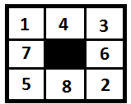
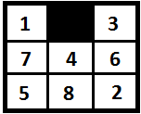
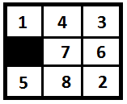
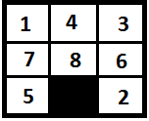
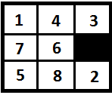
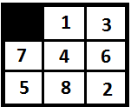
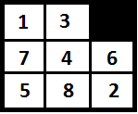
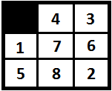
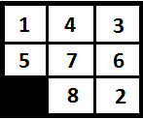
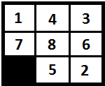
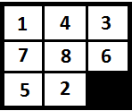
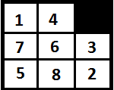
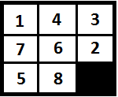
How big is the state space of the (n²-1)-puzzle?
8-puzzle → ?? states
Up
Right
Left
Down
L
R
U
D
L
R
U
D
Notes:
3

Slide 22
How big is the state space of the (n²-1)-puzzle?
8-puzzle → 9! = 362,880 states
15-puzzle → 16! ~ 2.09 x 10¹³ states
24-puzzle → 25! ~ 10²⁵ states
But only half of these states are reachable from any given state (but you may not know that in advance)
3
Notes:
3

Slide 23
8-, 15-, 24-Puzzles
8-puzzle → 362,880 states
15-puzzle → 2.09 x 10¹³ states
24-puzzle → 10²⁵ states
0.036 sec
~ 55 hours
> 10⁹ years
100 millions states/sec
Notes:
3

Slide 24
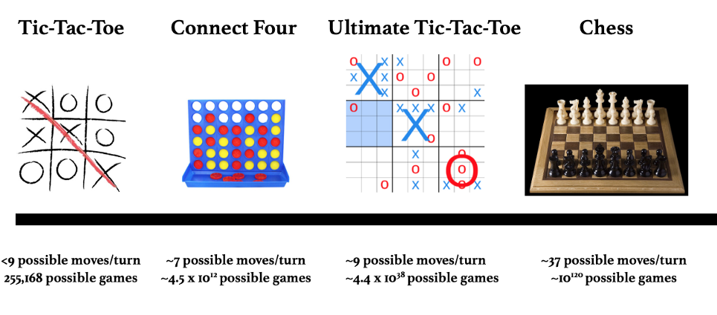
How big is the state space?
Notes:
3

Slide 25
Search Space Representation
A graph is undirected if arcs do not imply a direction, direct otherwise
A graph is connected if every pair of nodes is connected by a path
A connected graph with no loop is called tree
A weighted graph, is a graph for which a value is associated to each arc
undirect
direct
connected
disconnected
tree
weighted
1
1
4
5
2
1
6
2
1
Notes:
Any connected graph can be transformed to a tree (during the construction of the search space), loops lead to “infinite” trees. (this can be avoided by
forbidding to reiterate moves).
3

Slide 26
State Graph
Each state is represented by a distinct node
An arc (or edge) connects a node s to a node s’ if s’ ∈ SUCCESSORS(s)
The state graph may contain
more than one connected component
Notes:
3

Slide 27
Solution to the Search Problem
A solution is a path connecting the initial node to a goal node (any one)
G
I
Notes:
3

Slide 28
Solution to the Search Problem
A solution is a path connecting the initial node to a goal node (any one)
The cost of a path is the sum of the arc costs along this path
An optimal solution is a solution path of minimum cost
There might be
I
G
Notes:
3

Slide 29
Searching the State Space
It is often not feasible (or too expensive) to build a complete representation of the state graph
Notes:
3

Slide 30
Searching the State Space
Often it is not feasible (or too expensive) to build a complete representation of the state graph
A problem solver must construct a solution by exploring a small portion of the graph
Notes:
3

Slide 31
Searching the State Space
Search tree
Notes:
3

Slide 32
Searching the State Space
Search tree
Notes:
3

Slide 33
Searching the State Space
Search tree
Notes:
3

Slide 34
Searching the State Space
Search tree
Notes:
3

Slide 35
Searching the State Space
Search tree
Notes:
3

Slide 36
Searching the State Space
Search tree
Notes:
3

Slide 37
Search Tree
State graph
Search tree
Note that some states may be visited multiple times
Notes:
3

Slide 38
State Space Graphs vs. Search Trees
State Space Graph
Each NODE in in the search tree is an entire PATH in the state space graph.
Search Tree
S
a
G
d
e
p
b
c
q
b
c
e
h
r
d
e
f
a
a
h
r
p
q
f
S
h
We construct the tree on demand – and we construct as little as possible.
p
q
f
q
c
G
p
q
r
q
c
G
a
a
Notes:
3

Slide 39

Quiz: State Space Graphs vs. Search Trees
Consider this 4-state graph:
How big is its search tree (from S)?
a
S
G
b
Notes:
3

Slide 40
Quiz: State Space Graphs vs. Search Trees
Consider this 4-state graph:
How big is its search tree (from S)?
a
s
a
b
S
G
b
G
a
G
b
a
G
b
G
…
…
Important: Those who don’t know history are doomed to repeat it!
Notes:
3

Slide 41
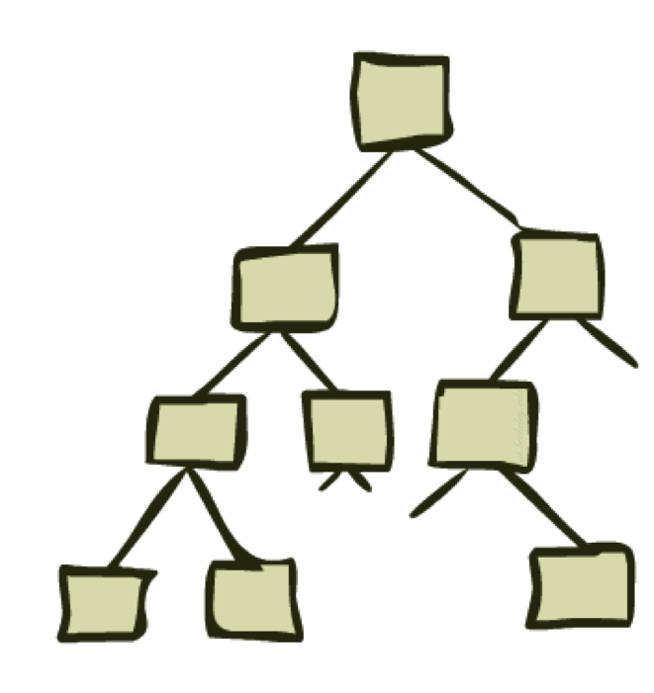
Search Trees
Notes:
3

Slide 42
Search Trees
Open List / Fringe: [ ]
Closed List / Visited: [ ]
Notes:
3

Slide 43
Search Nodes and States
8
2
3
4
7
5
1
6
8
2
7
3
4
5
1
6
8
2
8
2
8
4
2
8
2
3
4
7
3
4
7
3
7
3
4
7
5
1
6
5
1
6
5
1
6
5
1
6
Notes:
3

Slide 44
Search Nodes and States
8
2
3
4
7
5
1
6
8
2
7
If states are allowed to be revisited, the search tree may be infinite even
when the state space is finite
3
4
5
1
6
8
2
8
2
8
4
2
8
2
3
4
7
3
4
7
3
7
3
4
7
5
1
6
5
1
6
5
1
6
5
1
6
Notes:
3

Slide 45

Search Problems Are Models
Notes:
3

Slide 46
Problem solving
We want:
To automatically solve a problem.
We need:
A representation of the problem.
Algorithms that use some strategy to solve the problem defined in that representation.
Formalization
Searching technique
3
Notes:
3

Slide 47
AI searching Strategies
Searching Strategies in AI
Un-informed
(Blind Search)
Informed
(Heuristic Search)
Un-informed
(Blind Search)
Un-informed
(Blind Search)
Depth-first (DFS)
Breadth-First
(BFS)
Best-First
(BFS)
Hill
Climbing
Constraint Satisfaction
Depth-first (DFS)
Cost-First
(CFS)
Depth-
Limited
(DLS)
A* Search
Iterative
Deepening
(IDS)
A very large number of AI problems are formulated as search problems.
Notes:
3

Slide 48
Example
For a blind strategy, N₁ and N₂ are just two nodes (at some position in the search tree)
Strategies do not exploit state descriptions to order FRINGE
8
2
3
4
7
STATE
N₁
5
1
6
1
2
3
1
2
3
4
5
6
4
5
STATE
7
8
N₂
7
8
6
Goal state
Notes:
3

Slide 49
Example
For a heuristic strategy counting the number of misplaced tiles, N₂ is more promising than N₁
Strategies exploit state descriptions to order FRINGE
8
2
3
4
7
STATE
N₁
5
1
6
1
2
3
1
2
3
4
5
6
4
5
STATE
7
8
N₂
7
8
6
Goal state
Notes:
3

Slide 50
Data Structure of a Node
8
2
STATE
3
4
7
PARENT-NODE
5
1
6
BOOKKEEPING
CHILDREN
Action
Right
Depth
5
...
Path-Cost
5
Expanded
yes
Depth of a node N = length of path from root to N
(depth of the root = 0)
Notes:
3

Slide 51
Node expansion
8
2
The expansion of a node N of the search tree consists of:
Evaluating the successor function on STATE(N)
Generating a child of N for each state returned by the function
node generation ≠ node
3
4
7
5
1
6
N
8
2
8
4
2
8
2
3
4
7
3
7
3
4
7
5
1
6
5
1
6
5
1
6
Notes:
3

Slide 52
Fringe of Search Tree
The fringe is the set of all search nodes that haven’t been expanded yet
8
2
3
4
7
5
1
6
8
2
7
3
4
5
1
6
8
2
8
2
8
4
2
8
2
3
4
7
3
4
7
3
7
3
4
7
5
1
6
5
1
6
5
1
6
5
1
6
Notes:
3

Slide 53
Is it identical to the set of leaves?
Notes:
3

Slide 54
Search Strategy
Fringe:
Set of all search nodes that haven’t been expanded yet
Implemented as a priority queue FRINGE
INSERT(node, FRINGE)
REMOVE(FRINGE)
The ordering of the nodes in FRINGE defines the
Notes:
3

Slide 55
Blind vs. Heuristic Strategies
Blind (or un-informed) :
Strategies do not exploit state descriptions to order FRINGE.
They only exploit the positions of the nodes in the search tree.
Heuristic (or informed) :
Notes:
3

Slide 56
Performance Measures
Completeness:
A search algorithm is complete if it finds a solution whenever one exists [What about the case when no solution exists?]
Optimality:
A search algorithm is optimal if it returns a minimum-cost path whenever a solution exists
Complexity:
Notes:
3

Slide 57
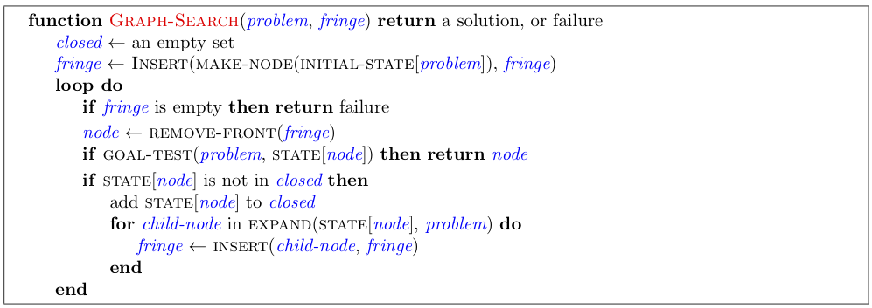
General Graph Search
Main variations:
Which leaf node to expand next
Whether to check for repeated states
Data structures for frontier, expanded nodes
Notes:
3

Slide 58
General Graph Search (Python)
INPUT: Start = S, Goal = G, SearchSpace = dictionary
OUTPUT: Status (True/False), Path, Goal
GraphSearch(SearchSpace, Start, Goal) :
OpenList = [S]
ClosedList = [ ]
while len(OpenList) :
N = remove_first(OpenList)
if N not in ClosedList : insert(N, ClosedList)
if N == Goal : return True, N
else:
childrens = SearchSpace [N]
for child in childrens :
if child not in ClosedList and child not in OpenList :
OpenList = append(OpenList, child)
return False
Note: this version is not saving the path for simplicity
Notes:
1 initialize the list (open for not closed nodes, closed for closed nodes)
2 insert in the open list the root node
3 while the open list is not empty
a. remove from the front of the list the first node
b. insert the current node in the front of the closed list
c. if the node is the goal state, return it
d. otherwise
i. Create the list of successors for the current node
ii. Add all the successors not already visited in front of the open list
remove-front corresponds to pop
insert-front corresponds to push
not-empty checks if the list is empty
successorsOf returns a right to left list of direct descendants
not-in checks if a node is not in a list
with two lists (open and closed) we avoid cycles that can appear in cyclic graphs
58

Slide 59
Search Algorithm #1
SEARCH#1
If GOAL?(initial-state) then return initial-state
INSERT(initial-node, FRINGE)
Repeat:
If empty(FRINGE) then return failure
N ← REMOVE(FRINGE)
s ← STATE(N)
For every state s’ in SUCCESSORS(s)
Create a new node N’ as a child of N
If GOAL?(s’) then return path or goal state
INSERT(N’,FRINGE)
Expansion of N
Notes:
58

Slide 60
Blind Strategies
Breadth-first
Bidirectional
Depth-first
Depth-limited
Iterative deepening
Uniform-Cost (variant of breadth-first)
Arc cost = 1
Arc cost
= c(action) ≥ ε > 0
Notes:
58

Slide 61

Depth-First Search
Notes:
58

Slide 62
Depth-First Strategy
New nodes are inserted at the front of FRINGE
1
2
3
FRINGE = (1)
4
5
Notes:
58

Slide 63
Depth-First Strategy
New nodes are inserted at the front of FRINGE
1
2
3
FRINGE = (2, 3)
4
5
Notes:
58

Slide 64
Depth-First Strategy
New nodes are inserted at the front of FRINGE
1
2
3
FRINGE = (4, 5, 3)
4
5
Notes:
58

Slide 65
Depth-First Strategy
New nodes are inserted at the front of FRINGE
1
2
3
4
5
Notes:
58

Slide 66
Depth-First Strategy
New nodes are inserted at the front of FRINGE
1
2
3
4
5
Notes:
58

Slide 67
Depth-First Strategy
New nodes are inserted at the front of FRINGE
1
2
3
4
5
Notes:
58

Slide 68
Depth-First Strategy
New nodes are inserted at the front of FRINGE
1
2
3
4
5
Notes:
58

Slide 69
Depth-First Strategy
New nodes are inserted at the front of FRINGE
1
2
3
4
5
Notes:
58

Slide 70
Depth-First Strategy
New nodes are inserted at the front of FRINGE
1
2
3
4
5
Notes:
58

Slide 71
Depth-First Strategy
New nodes are inserted at the front of FRINGE
1
2
3
4
5
Notes:
58

Slide 72
Depth-First Strategy
New nodes are inserted at the front of FRINGE
1
2
3
4
5
Notes:
58

Slide 73
Depth-First Search
Strategy: expand a deepest node first
Implementation: Fringe is a LIFO stack
a
G
b
c
d
e
f
S
h
p
q
r
S
d
e
p
b
c
e
h
r
q
a
a
h
r
p
q
f
p
q
f
q
c
G
q
c
G
a
a
Notes:
58

Slide 74
Depth-First Search
Strategy: expand a deepest node first
Implementation: Fringe is a LIFO stack
a
G
a
c
b
c
b
e
d
e
d
f
f
S
h
h
p
p
r
q
r
q
S
d
e
p
b
c
e
h
r
q
a
a
h
r
p
q
f
p
q
f
q
c
G
q
c
G
a
a
Notes:
58

Slide 75
Depth-First Search
Strategy: expand a deepest node first
Implementation: Fringe is a LIFO stack
a
G
a
c
b
c
b
e
d
e
d
f
f
S
h
h
p
p
r
q
r
q
S
d
e
p
b
c
e
h
r
q
a
a
h
r
p
q
f
p
q
f
q
c
G
q
c
G
a
a
Notes:
58

Slide 76
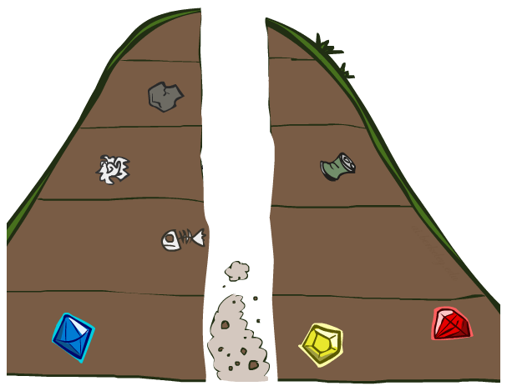
Search Algorithm Properties
Notes:
58

Slide 77
Search Algorithm Properties
Complete: Guaranteed to find a solution if one exists?
Optimal: Guaranteed to find the least cost path?
Time complexity?
Space complexity?
Sketch of search tree:
b is the branching factor
m is the maximum depth
solutions at various depths
Number of nodes in entire tree?
1 + b + b² + …. b^{m} = O(b^{m})
1 node
b
…
b nodes
b² nodes
m tiers
b^{m} nodes
Notes:
58

Slide 78
Depth-First Search (DFS) Properties
What nodes does DFS expand?
Some left prefix of the tree down to depth m.
Could process the whole tree!
If m is finite, takes time O(b^{m})
How much space does the frontier take?
Only has siblings on path to root, so O(bm)
Is it complete?
m could be infinite
preventing cycles may help (more later)
Is it optimal?
No, it finds the “leftmost” solution, regardless of depth or cost
1 node
b
…
b nodes
b² nodes
m tiers
b^{m} nodes
Notes:
58

Slide 79
Depth-Limited Search
Depth-first with depth cutoff k (depth at which nodes are not expanded)
Three possible outcomes:
Solution
Failure (no solution)
Cutoff (no solution within cutoff)
Notes:
58

Slide 80
Iterative Deepening
Idea: get DFS’s space advantage with BFS’s time / shallow-solution advantages
Run a DFS with depth limit 1. If no solution…
Run a DFS with depth limit 2. If no solution…
Run a DFS with depth limit 3. …..
Isn’t that wastefully redundant?
Generally, most work happens in the lowest level searched, so not so bad!
b
…
Notes:
1 + (1+b) + (1+b+b²) + … + (1+b+…+b^{s}) = (s+1) + sb + (s-1)b² + … + b^{s} = O(b^{s})
58

Slide 81
Iterative Deepening Search
Provides the best of both breadth-first and depth-first search
Main idea:
Totally horrifying !
IDS
For k = 0, 1, 2, … do:
Perform depth-first search with depth cutoff k
(i.e., only generate nodes with depth ≤ k)
Notes:
58

Slide 82
Iterative Deepening
Notes:
58

Slide 83
Iterative Deepening
Notes:
58

Slide 84
Iterative Deepening
Notes:
58

Slide 85
Performance
Iterative deepening search is:
Complete
Optimal if step cost =1
Time complexity: b^{d} + 2b^{d-1} + 3b^{d-2} + …. + (d - 1) b² + db + (d + 1) = O(b^{d})
Space complexity: O(bd) or O(d)
Notes:
58

Slide 86
Number of Generated Nodes (Breadth-First & Iterative Deepening)
d = 5 and b = 2
d | BF | ID
0 | 1 | 1 x 6 = 6
1 | 2 | 2 x 5 = 10
2 | 4 | 4 x 4 = 16
3 | 8 | 8 x 3 = 24
4 | 16 | 16 x 2 = 32
5 | 32 | 32 x 1 = 32
SUM | 63 | 120
120/63 ~ 2
Notes:
58

Slide 87
Number of Generated Nodes (Breadth-First & Iterative Deepening)
d = 5 and b = 10
d | BF | ID
0 | 1 | 6
1 | 10 | 50
2 | 100 | 400
3 | 1,000 | 3,000
4 | 10,000 | 20,000
5 | 100,000 | 100,000
SUM | 111,111 | 123,456
123,456/111,111 ~ 1.111
Notes:
58

Slide 88
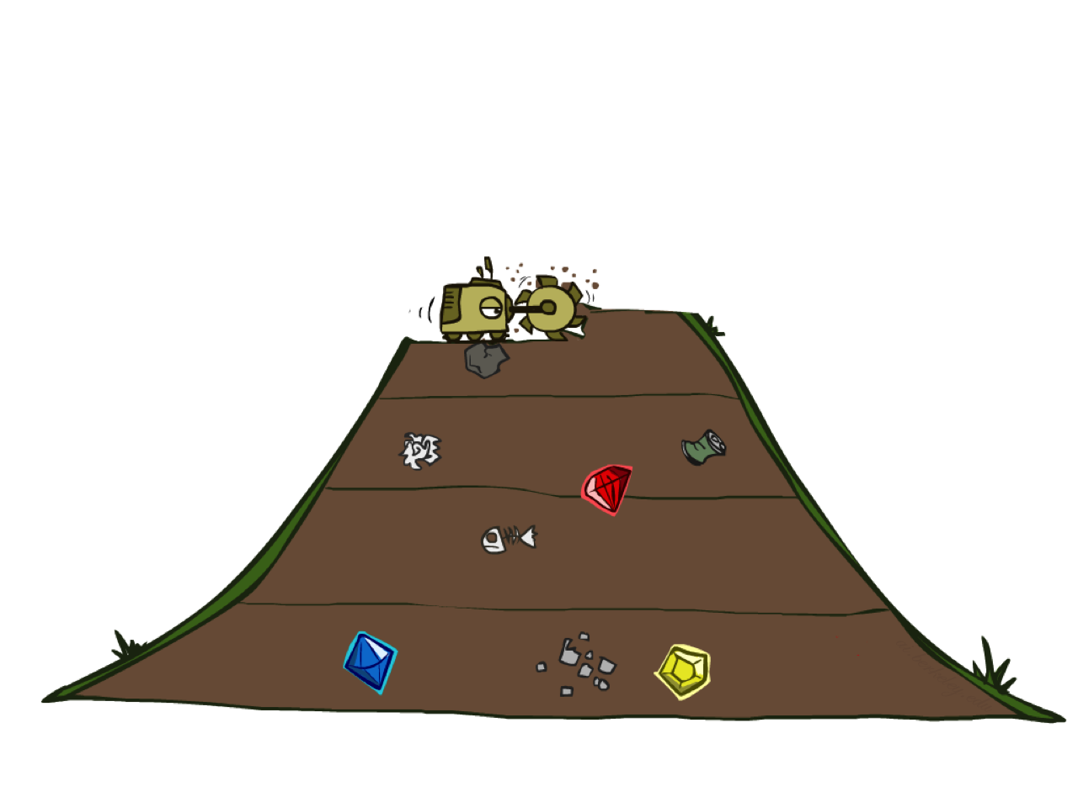
Breadth-First Search
Notes:
58

Slide 89
Depth-First Search
Strategy: expand a shallowest node first
Implementation: Fringe is a FIFO queue
a
G
b
c
d
e
f
S
h
p
q
r
S
d
e
p
b
c
e
h
r
q
a
a
h
r
p
q
f
p
q
f
q
c
G
q
c
G
a
a
Notes:
58

Slide 90
Breadth-First Strategy
New nodes are inserted at the end of FRINGE
1
2
3
FRINGE = (1)
4
5
6
7
Notes:
58

Slide 91
Breadth-First Strategy
New nodes are inserted at the end of FRINGE
1
2
3
FRINGE = (2, 3)
4
5
6
7
Notes:
58

Slide 92
Breadth-First Strategy
New nodes are inserted at the end of FRINGE
1
2
3
FRINGE = (3, 4, 5)
4
5
6
7
Notes:
58

Slide 93
Breadth-First Strategy
New nodes are inserted at the end of FRINGE
1
2
3
FRINGE = (4, 5, 6, 7)
4
5
6
7
Notes:
58

Slide 94
Breadth-First Search
Strategy: expand a shallowest node first
Implementation: Fringe is a FIFO queue
a
G
b
c
d
e
f
S
h
p
q
r
S
d
e
p
b
c
e
h
r
q
a
a
h
r
p
q
f
p
q
f
q
c
G
q
c
G
a
a
Notes:
58

Slide 95
Breadth-First Search (BFS) Properties
What nodes does BFS expand?
Processes all nodes above shallowest solution
Let depth of shallowest solution be s
Search takes time O(b^{s})
How much space does the frontier take?
Has roughly the last tier, so O(b^{s})
Is it complete?
s must be finite if a solution exists, so yes!
Is it optimal?
If costs are equal (e.g., 1)
1 node
b
…
b nodes
s tiers
b² nodes
b^{s} nodes
b^{m} nodes
Notes:
58

Slide 96
Bidirectional Strategy
2 fringe queues: FRINGE1 and FRINGE2
s
Time and space complexity is O(b^{d/2}) << O(b^{d}) if both trees have the same branching factor b
Notes:
58

Slide 97
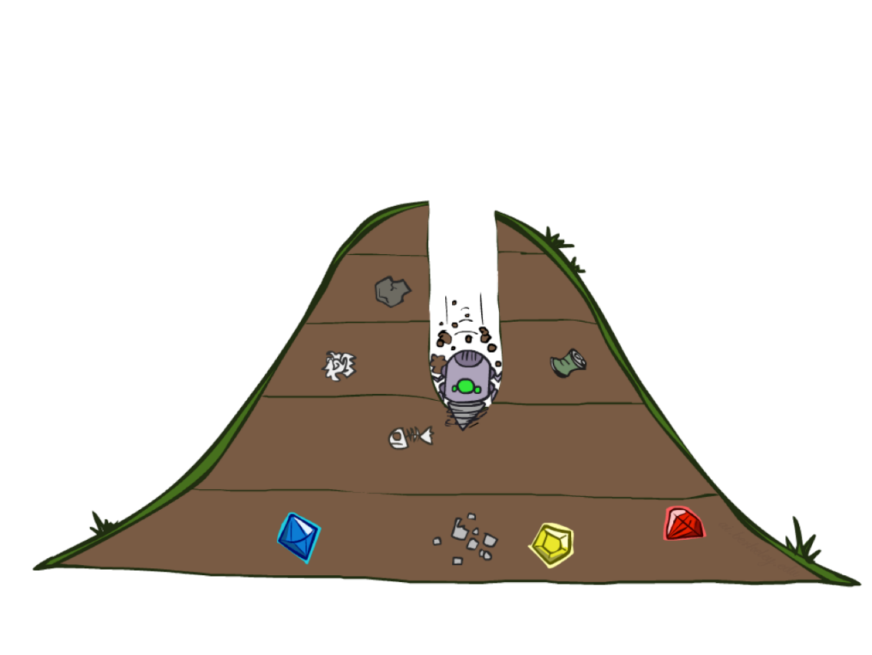
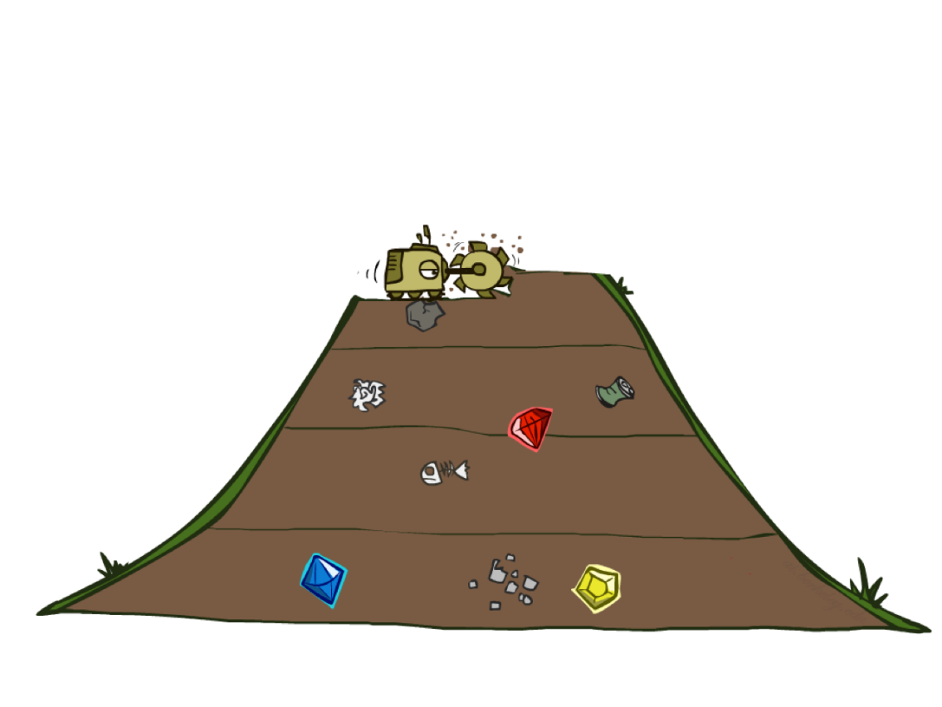
Quiz: DFS vs BFS
Notes:
58

Slide 98

Uniform Cost Search
Notes:
58

Slide 99
Uniform Cost Search
2
G
a
g(n) = cost from root to n
Strategy: expand lowest g(n)
Fringe is a priority queue sorted by g(n)
b
c
1
8
2
2
e
3
d
f
9
8
2
S
h
1
1
p
q
r
15
S
d
e
p
b
c
e
h
r
q
a
a
h
r
p
q
f
p
q
f
q
c
G
q
c
G
a
a
Notes:
58

Slide 100
Uniform Cost Search
2
G
a
g(n) = cost from root to n
Strategy: expand lowest g(n)
Fringe is a priority queue sorted by g(n)
b
c
1
8
2
2
e
3
d
f
9
8
2
S
h
1
1
p
q
r
15
0
S
d
3
e
9
p
1
b
4
c
e
5
h
r
q
16
11
a
6
a
h
13
r
7
p
q
f
p
q
f
8
q
c
G
q
c
a
11
G
10
a
Notes:
58

Slide 101
Uniform Cost Search
Each arc has some cost c ≥ ε > 0
The cost of the path to each node N is
g(N) = Σ costs of arcs
The goal is to generate a solution path of minimal cost
The nodes N in the queue FRINGE are sorted in increasing g(N)
Need to modify search algorithm
A
S
0
1
10
S
5
B
5
G
A
B
C
1
5
15
5
15
C
G
G
11
10
Notes:
58

Slide 102
Search Algorithm #2
The goal test is applied
to a node when this node is
expanded, not when it is
generated.
SEARCH#2
INSERT(initial-node, FRINGE)
Repeat:
If empty(FRINGE) then return failure
N ← REMOVE(FRINGE)
s ← STATE(N)
If GOAL?(s) then return path or goal state
For every state s’ in SUCCESSORS(s)
Create a node N’ as a successor of N
INSERT(N’,FRINGE)
Notes:
58

Slide 103
Uniform Cost Search (UCS) Properties
What nodes does UCS expand?
Processes all nodes with cost less than cheapest solution!
If that solution costs C* and arcs cost at least ε , then the “effective depth” is roughly C*/ε
Takes time O(b^{C*/ε}) (exponential in effective depth)
How much space does the frontier take?
Has roughly the last tier, so O(b^{C*/ε})
Is it complete?
Assuming C* is finite and ε > 0, yes!
Is it optimal?
Yes! (Proof next lecture via A*)
b
g ≤ 1
…
C*/ε “tiers”
g ≤ 2
g ≤ 3
Notes:
58

Slide 104
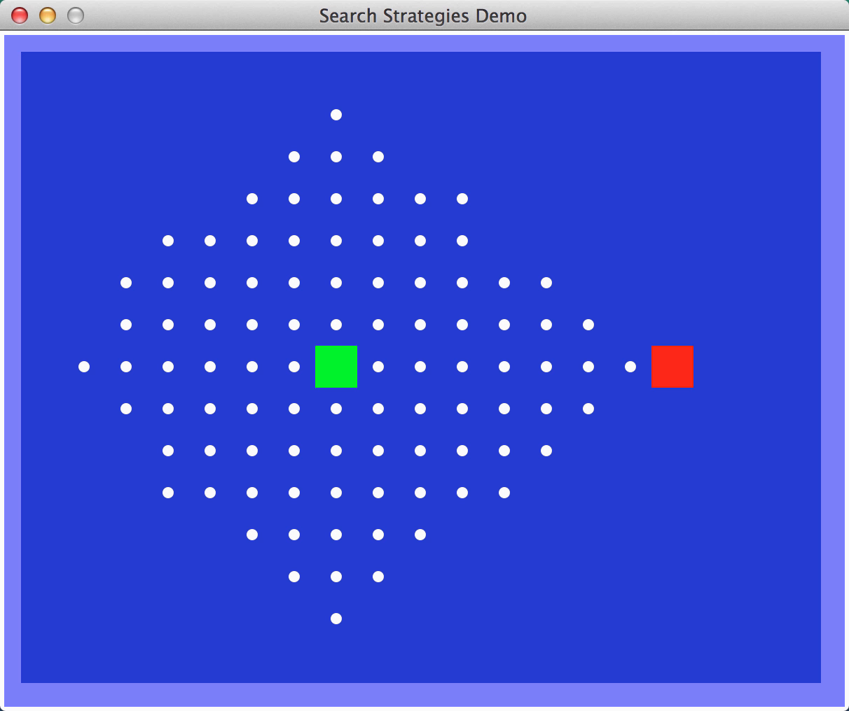
Video of Demo Empty UCS
Notes:
58

Slide 105
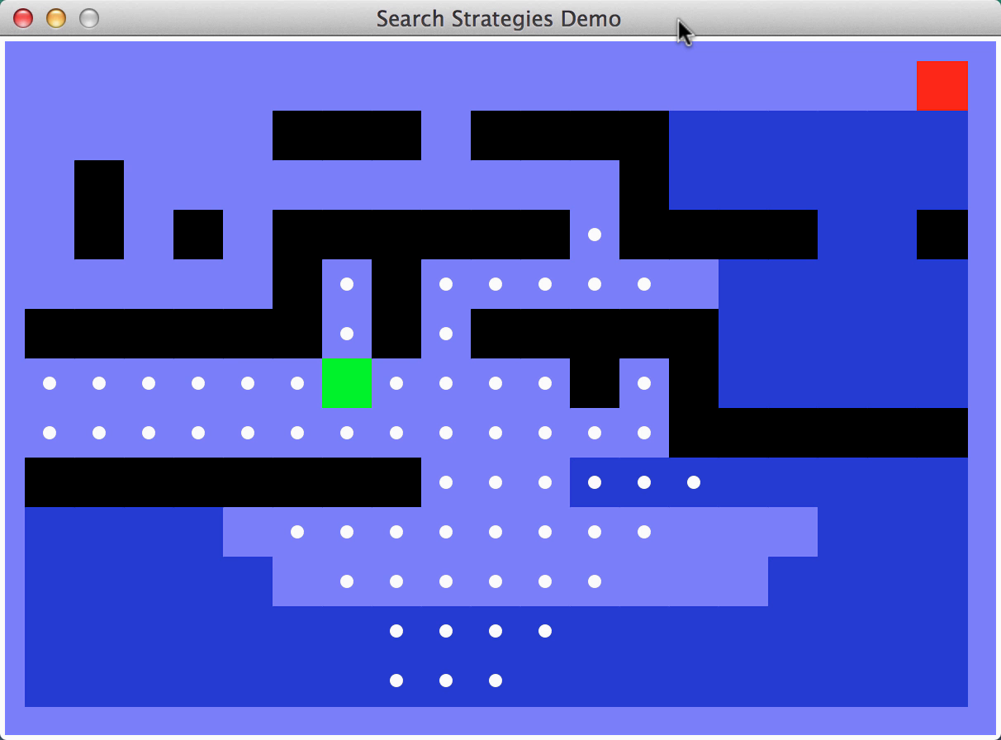
Video of Demo Maze with Deep/Shallow Water --- BFS or UCS? (part 1)
Notes:
Cost 1 for shallow, 2 for deep water. Let students guess which one of the three it is. (This is BFS.)
58

Slide 106
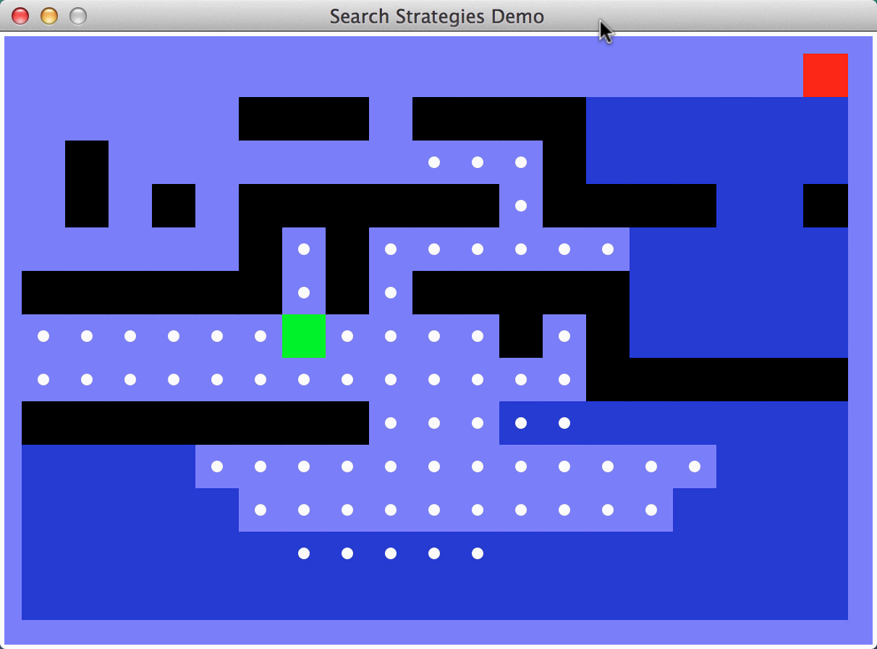
Video of Demo Maze with Deep/Shallow Water --- BFS or UCS? (part 2)
Notes:
Let students guess which one of the three it is. (This is UCS.)
58

Slide 107
Time and Memory Requirements
d | # Nodes | Time | Memory
2 | 111 | .01 msec | 11 Kbytes
4 | 11,111 | 1 msec | 1 Mbyte
6 | ~10⁶ | 1 sec | 100 Mb
8 | ~10⁸ | 100 sec | 10 Gbytes
10 | ~10¹⁰ | 2.8 hours | 1 Tbyte
12 | ~10¹² | 11.6 days | 100 Tbytes
14 | ~10¹⁴ | 3.2 years | 10,000 Tbytes
Assumptions: b = 10; 1,000,000 nodes/sec; 100bytes/node
Notes:
58

Slide 108
Time and Memory Requirements
d | # Nodes | Time | Memory
2 | 111 | .01 msec | 11 Kbytes
4 | 11,111 | 1 msec | 1 Mbyte
6 | ~10⁶ | 1 sec | 100 Mb
8 | ~10⁸ | 100 sec | 10 Gbytes
10 | ~10¹⁰ | 2.8 hours | 1 Tbyte
12 | ~10¹² | 11.6 days | 100 Tbytes
14 | ~10¹⁴ | 3.2 years | 10,000 Tbytes
Assumptions: b = 10; 1,000,000 nodes/sec; 100bytes/node
Notes:
58

Slide 109
Revisited States
No
Few
Many
1
2
3
search tree is finite
search tree is infinite
4
5
7
8
6
8-queens
assembly planning
8-puzzle and robot navigation
Notes:
58

Slide 110
Avoiding Revisited States
Requires comparing state descriptions
Breadth-first search:
Store all states associated with generated nodes in VISITED
If the state of a new node is in VISITED, then discard the node
Implemented as hash-table
or as explicit data structure with flags
Notes:
58

Slide 111
Avoiding Revisited States
Depth-first search:
Solution 1:
Store all states associated with nodes in current path in VISITED
If the state of a new node is in VISITED, then discard the node
??
Notes:
58

Slide 112
Avoiding Revisited States
Depth-first search:
Solution 1:
Store all states associated with nodes in current path in VISITED
If the state of a new node is in VISITED, then discard the node
Only avoids loops
Solution 2:
Store all generated states in VISITED
If the state of a new node is in VISITED, then discard the node
→
Notes:
58

Slide 113
Simple Problem-Solving-Agent Algorithm
s₀ ← sense/read initial state
GOAL? ← select/read goal test
Succ ← read successor function
solution ← search(s₀, GOAL?, Succ)
perform(solution)
Notes:
58

Slide 114
Comparison of Strategies
Measures | DFS | DLS | IDS | BFS | BDS | UCS
Time
Space
Optimal | No | No | Yes | Yes | Yes | Yes
Complete | No |  | Yes | Yes | Yes | Yes
Notes:
<number>

Slide 115
Comparison of Strategies
Breadth-first is complete and optimal, but has high space complexity
Depth-first is space efficient, but is neither complete, nor optimal
Iterative deepening is complete and optimal, with the same space complexity as depth-first and almost the same time complexity as breadth-first
Notes:
<number>

Slide 116
Avoiding Revisited States in Uniform-Cost Search
For any state S, when the first node N such that STATE(N) = S is expanded, the path to N is the best path from the initial state to S
N
N”
N’
g(N) ≤ g(N’)
g(N) ≤ g(N”)
Notes:
<number>

Slide 117
Avoiding Revisited States in Uniform-Cost Search
For any state S, when the first node N such that STATE(N) = S is expanded, the path to N is the best path from the initial state to S
So:
When a node is expanded, store its state into CLOSED
When a new node N is generated:
If STATE(N) is in CLOSED, discard N
If there exits a node N’ in the fringe such that STATE(N’) = STATE(N), discard the node -- N or N’ -- with the highest-cost path
Notes:
<number>

